Slide 1
Department of Mathematics and Natural Sciences
CHE 101: Introduction to Chemistry
Lecturer: Afsana Tasnim Oshin
Section A, Lecture 3
Content: Different quantum numbers, orbit and orbital, electronic configurations

Slide 2
Orbit and orbital
In an atom electrons move around the nucleus in a two dimensional, spherical fixed energy levels which is called the orbit.
The orbit nearest to the nucleus is the first energy level and is called ‘K shell’.
The next orbits are named as L, M, N and so on.
The three dimensional region in space around the nucleus where the probability of finding an electron is maximum (90-95 %) is called orbital.
On each orbital maximum number of electron is two

Slide 3
Difference between orbit and orbital
Orbit | Orbital
Orbits are definite path or energy level followed by an electron, according to Bohr | The three dimensional region in space around the nucleus where the probability of finding an electron is maximum (90-95 % ) is called orbital.
It is represented two dimensionally. | An orbital is three dimensional representation.
The orbits may be circular or elliptical. | Different orbitals have different shapes. e.g. s orbital spherical, p orbital dumbbell shaped
Two orbits in an atom cannot have the same energy. | Two orbitals can have the same energy e.g., p_{x} p_{y}, p_{z} have the same energy.
An orbit can hold 2n² number of electrons where n is the principle quantum number having the values 1, 2, 3 etc. | Each orbital can hold maximum two electrons of opposite spin e.g. s orbital holds 2, three p orbitals hold 6 and 5d orbitals hold 10 electrons.

Slide 4
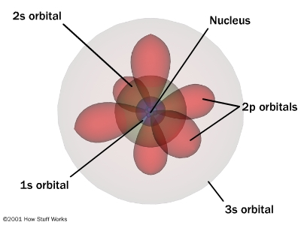
Different types of orbitals
There are four types of orbital: s, p, d and f
1) s-orbital is spherical shaped with nucleus at the center
2) p-orbital is dumbbell shaped
It’s divided into three orbital with same energy
They are p_{x} p_{y}, p_{z}
They lie on x, y and z axis perpendicular to each other
3) d-orbital - there are five different orbitals
4) f-orbital - there are seven f orbitals

Slide 5
Quantum Numbers
Quantum numbers are a set of values that describes the state of an electron including the size of an electron orbit (energy levels), the shape of the orbitals, orientation of orbital in the magnetic field and the spin of electrons about its own axis.
****quantum number is the way to finding electron.
The above four characteristics are represented by four Quantum Numbers
Principal quantum number (n)(area)
Azimuthal or subsidiary quantum number (l)(road)
Magnetic quantum number (m_{l})(house no)
Spin quantum number (m_{s})(apartment number)

Slide 6
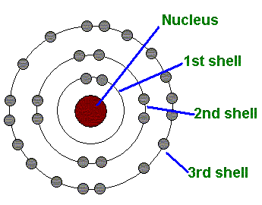
i) Principal quantum number (n)
Express
Number of energy level
Indicates
size of orbit
distance of orbit from nucleus
(n = 1)
(n = 2)
Energy of electrons
(n = 3)
Determine
total number of electrons in a shell (by 2n²)
K L M N …..
Shells are designated by letters also
1 2 3 4 …..
Notes:
Orbit high== volume high, high orbit= more reactive

Slide 7
ii) Azimuthal quantum number (l)
Express
Concepts of orbitals of different shapes
possible values of l
0 to (n-1)
e.g. n = 3, l = 0, 1, 2
Indicates
shapes and numbers of orbitals in a shell
Determine
total number of electrons in an orbital as 2(2l+1)
Subshells are denoted by letters as
Letter s p d f g …
l 0 1 2 3 4 ...
Maximum number of electrons
2 6 10 14

Slide 8
iii) Magnetic quantum number (m_{l})
indicates
orientation of orbitals in 3 dimensional space
-l through 0 to +l
For l = 0, m_{l} = 0 (s subshell)
For l = 1, m_{l} = -1, 0, +1 (p subshell)
allowed values
Determine
total number of orbital in a subshell

Slide 9
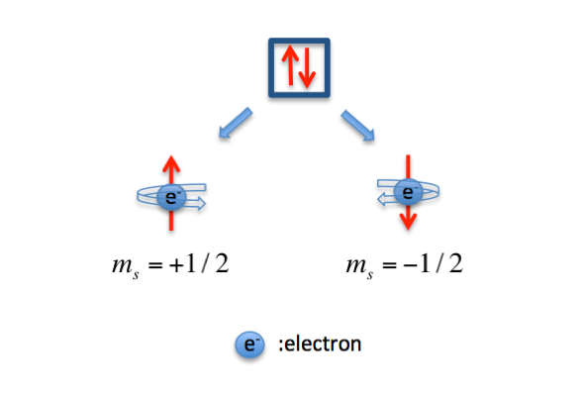
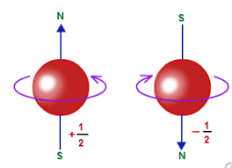
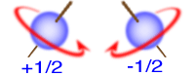
iii) Spin quantum number (m_{s})
indicates
Two possible orientation of the spin axis of an electron
possible values
+1/2 or -1/2 for each value of m
Notes:
Strong elcetron always spin up and weak electron always go down

Slide 10
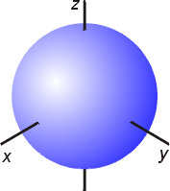
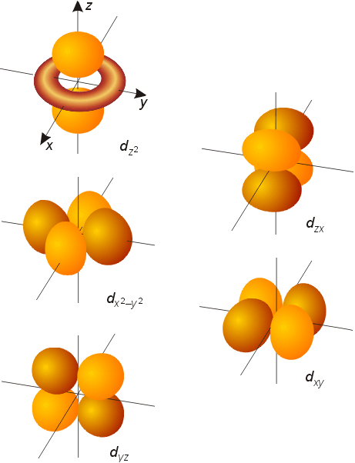
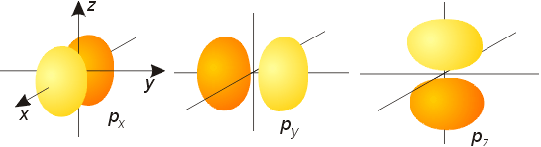
Different types of orbital with different quantum numbers
s
l=0, m=0
l=1, m=-1
l=1, m=0
l=1, m=+1

Slide 11
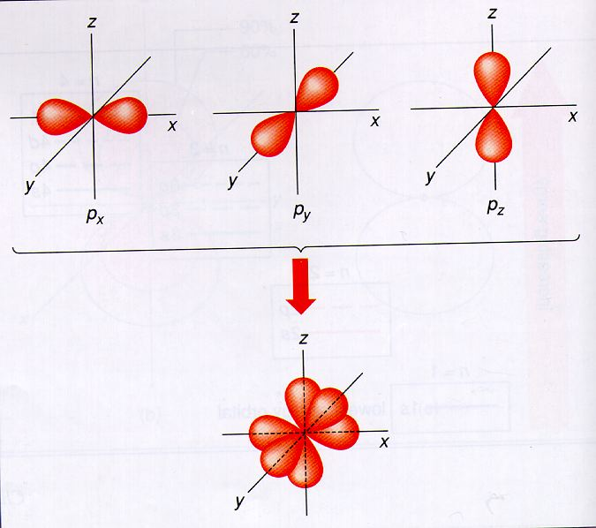
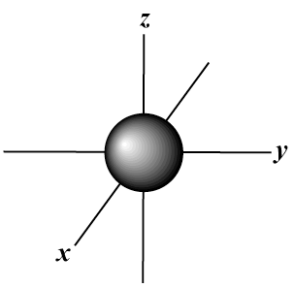
Shapes of different types of orbital
s-orbital (spherical shape)
p-orbitals (dumbbell shaped)

Slide 12
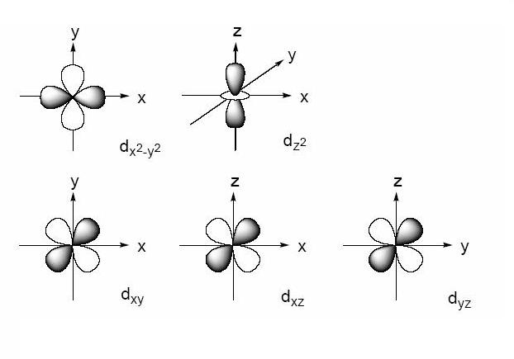
Shapes of five different d-orbitals

Slide 13
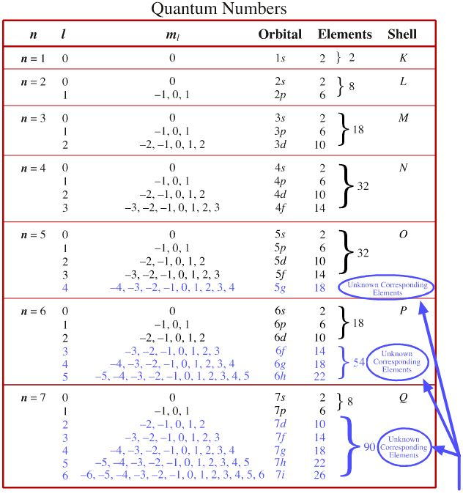
Quantum Numbers

Slide 14
Quantum Numbers

Slide 15
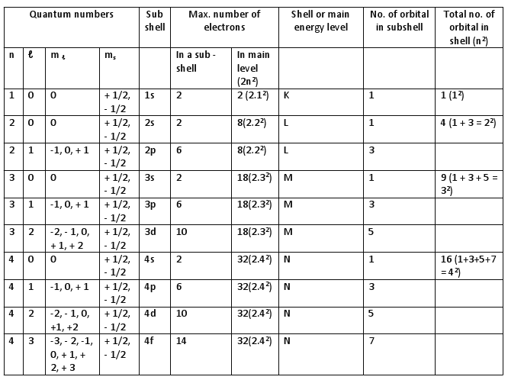
Quantum Numbers & related informations

Slide 16
Q: Supply the values of the missing quantum numbers and sublevel names.
n l m_{l} Name
(i) ? ? 0 4p
(ii) 2 1 0 ?
(iii) 3 2 -2 ?
(iv) ? ? ? 2s

Slide 17
Q: According to the concept of the quantum numbers which of the following orbitals are possible and which are not? Give possible explanation against your reasons.
i) 2p ii) 2d iii) 3d iv) 1p
Q: Explain why each of the following sets of quantum numbers is not permissible for an orbital
(i) n = 0, l = 1, m_{l} = 0, m_{s} = +1/2
(ii ) n = 3, l = 2, m_{l} = +3, m_{s} = -1/2

Slide 18
Electronic Configuration of Atoms
In an atom the electrons are held in different orbits, sub-shells and orbital in a regular way. This arrangement of electrons in an atom is called the electronic configuration.
Principles that influence the electronic configuration of atom:
Pauli’s exclusion principle
Aufbau principle
Hund’s rule

Slide 19
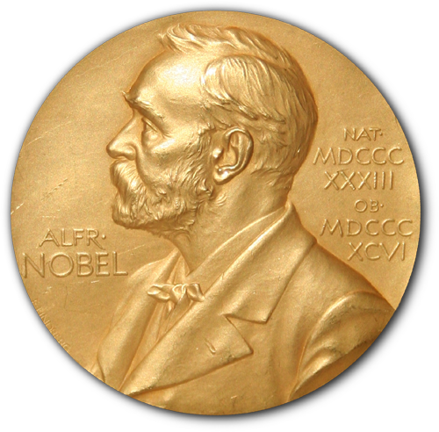
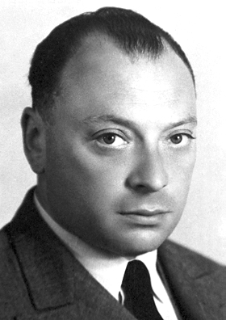
Wolfgang Pauli 1900-1958
Nobel Prize in Physics 1945
"for the discovery of the Exclusion Principle, also called the Pauli Principle."

Slide 20
Pauli’s exclusion principle
According to this principle, ‘no two electrons in the same atom can have the same values for the four quantum numbers’.
For example, He (helium) had two electrons in 1s orbital and their electronic configuration is 1s², that means they had two electrons in the 1s orbital. This two electrons can have same values for three of their quantum numbers, but the fourth quantum number must be different for the two electrons.
Electronic configuration of helium atom is:
He (2) = 1s²
For the first electron, n = 1, l = 0, m_{l} = 0, m_{s} = +1/2
And for the second electron, n = 1, l = 0, m_{l} = 0, m_{s} = -1/2
So, these two electrons have different values of their spin quantum number.

Slide 21
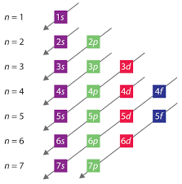
Aufbau principle
According to this principle, ‘the electrons will first occupy the lowest energy levels’.
The energy of the levels are determined by their (n + l) values.
The electron will first occupy the orbital having the lowest value of (n + l)
Q. In which orbital the electron will go first if the values of (n + l) is same for both of the orbital?
Ans: In that case the electron goes to the orbital with lowest value of ‘n’.
Figure: Filling of electrons in various orbitals according to (n+1) rules
Increasing order of energies of the atomic orbitals:
1s < 2s < 2p < 3s < 3p < 4s < 3d < 4p < 5s…………

Slide 22
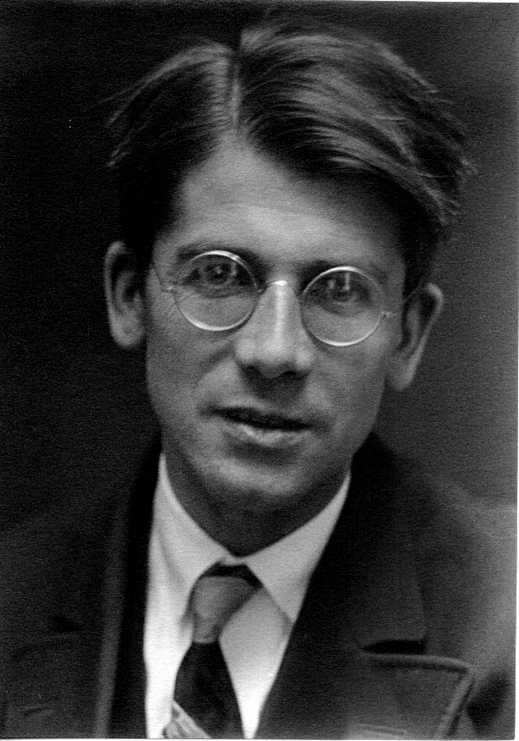
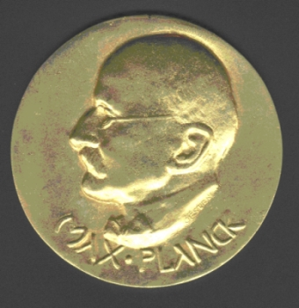
Friedrich Hund 1896-1997
Max Planck Medal in Physics 1943

Slide 23
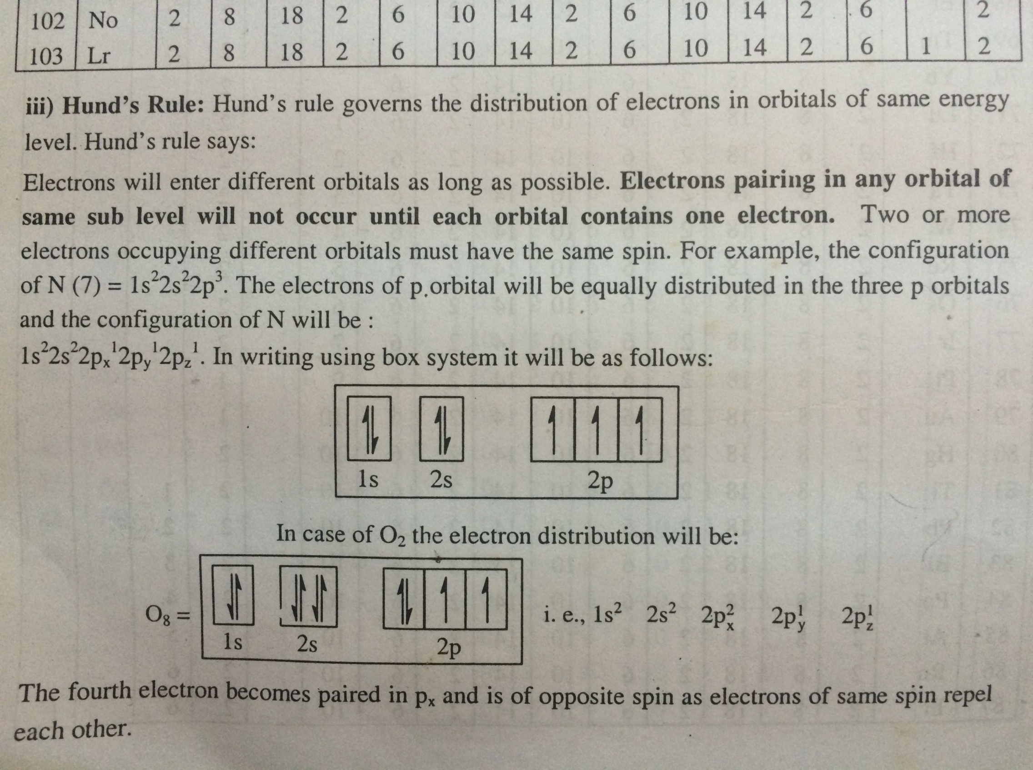
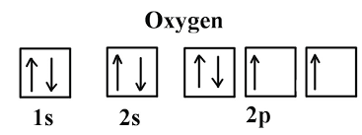
Hund’s rule
According to this rule, ‘electron pairing in any orbital of same sub level will not occur until each orbital contains one electron’.
For example:
Electronic configuration of nitrogen atom is: N (7) = 1s² 2s² 2p_{x}¹ 2p_{y}¹ 2p_{z}¹
The electrons of p orbital will be equally distributed in three p orbital ant the configuration of N will be:
O (8) = 1s² 2s² 2p_{x}² 2p_{y}¹ 2p_{z}¹
The fourth electron become paired up in p_{x} and is of opposite spin as electron of same spin repel each other.

Slide 24
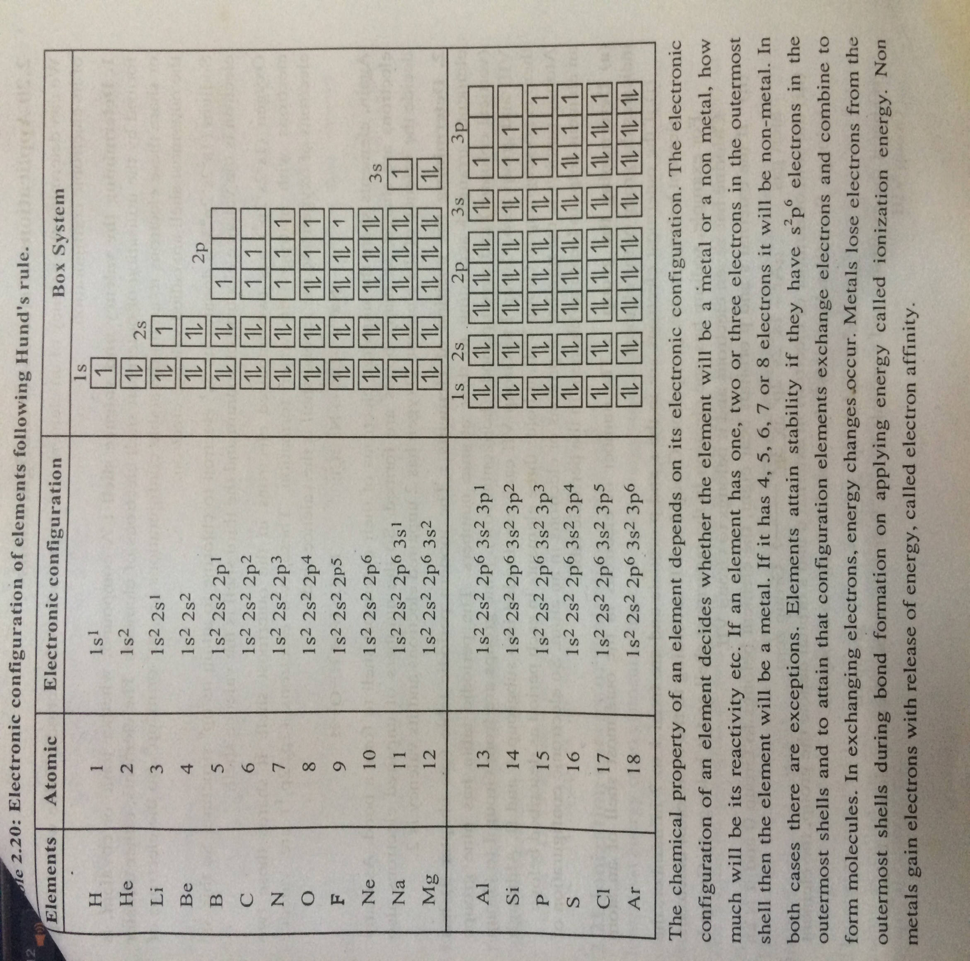
Electronic configuration of elements following Hund’s rule

Slide 25
Thanks to All

